Slide 1


JCW: An Analysis of Attrition 2015-2016
www.xandertalent.com

Slide 2



Welcome !
Hi! I’m Louis
Data Analytics
Associate
Cohort 4
Former teacher

Slide 3
Content
Overview
Univariate Analysis
Bivariate Analysis
Key Findings
Suggestions

Slide 4
Content
Overview
Univariate Analysis
Bivariate Analysis
Key Findings
Suggestions

Slide 5
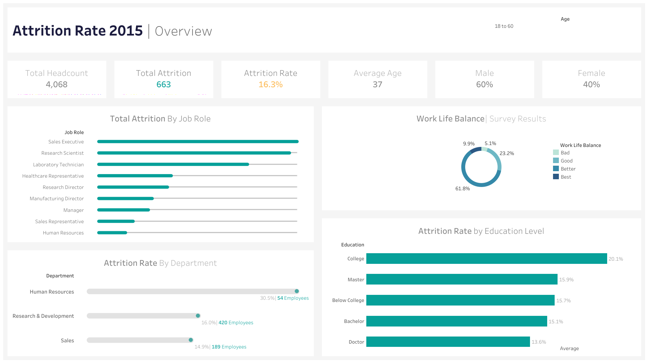

Slide 6
Content
Overview
Univariate Analysis
Bivariate Analysis
Key Findings
Suggestions

Slide 7
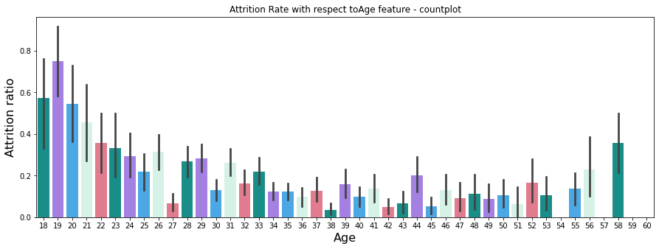
How does Age affect Attrition?
Ages 20-24 2x
as likely to leave as
ages 30-50.
Over 50% of
employees 23 and
younger exited.
76% of 19 year old employees exited.

Slide 8
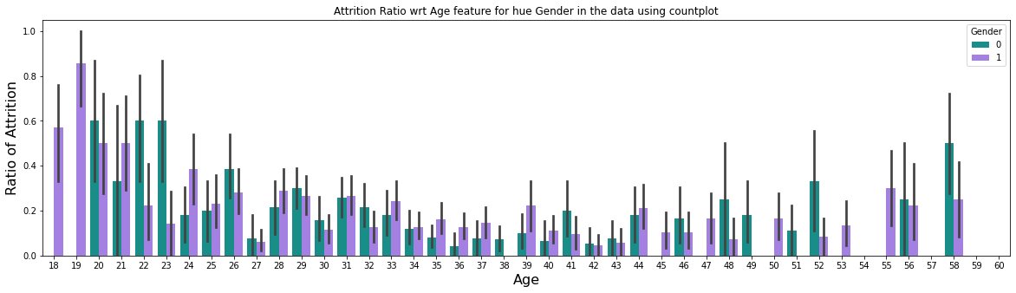
How does Age affect Attrition?
This trend continues irrespective of Gender.

Slide 9
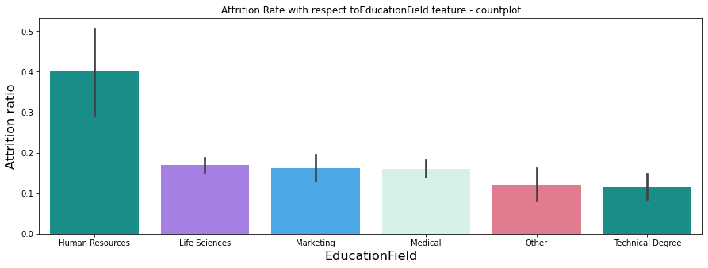
How does Education affect Attrition?
Employees from a Human Resources background more than twice as likely to leave.

Slide 10
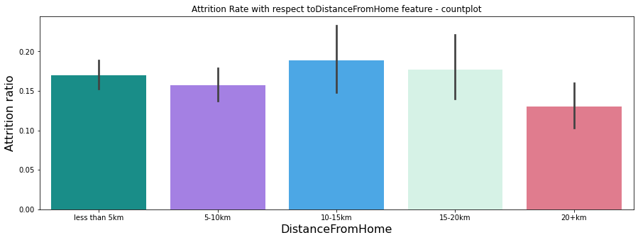
How does travel distance affect Attrition?
We see no significant correlation between distance travelled from home and the rate of attrition.

Slide 11
How does travel distance affect Attrition?
We see no significant correlation between distance travelled from home and the rate of attrition.

Slide 12
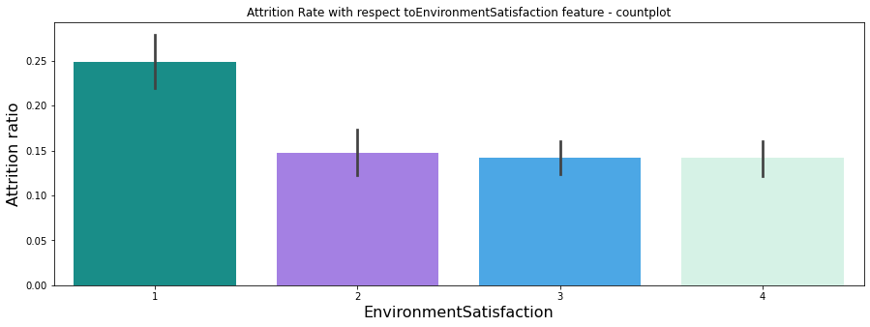
How does environment satisfaction
affect Attrition?
Key:
1 = Bad
2 = Good
3 = Better
4 = Best
Employees with low environment satisfaction were more than 80% more likely to leave than average.

Slide 13
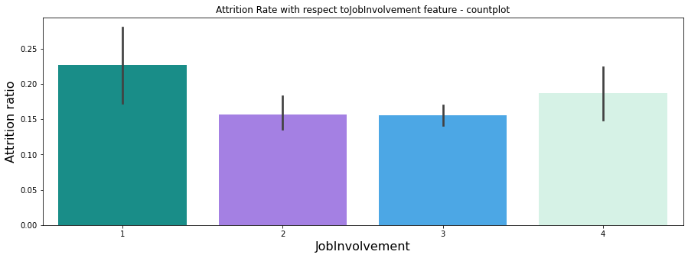
How does job involvement affect Attrition?
Key:
1 = Bad
2 = Good
3 = Better
4 = Best
We see no significant correlation between job involvement and attrition rate.

Slide 14
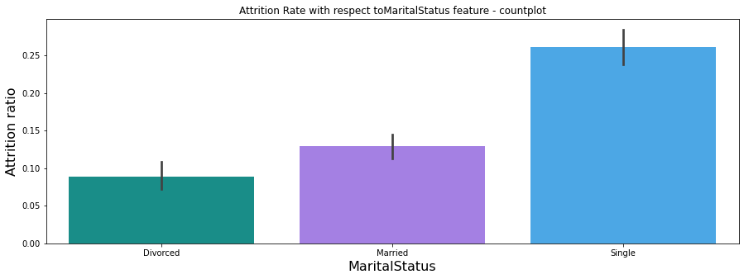
How does marital status affect Attrition?
Single employees are almost 3 times as likely to leave as married or divorced.

Slide 15
How does marital status affect Attrition?
Single employees are almost 3 times as likely to leave as married or divorced.

Slide 16
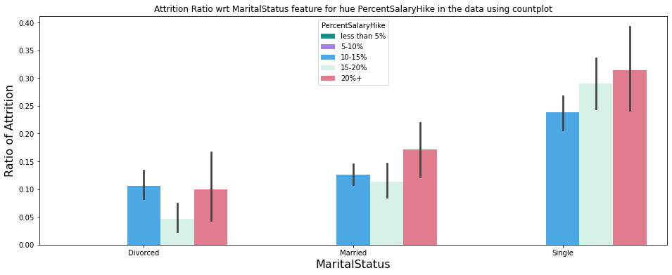
How does marital status affect Attrition?
This trend is irrespective of income and pay increase, with over 30% of single employees leaving despite a 20%+ pay rise.

Slide 17
How does marital status affect Attrition?
This trend is irrespective of income and pay increase, with over 30% of single employees leaving despite a 20%+ pay rise.

Slide 18
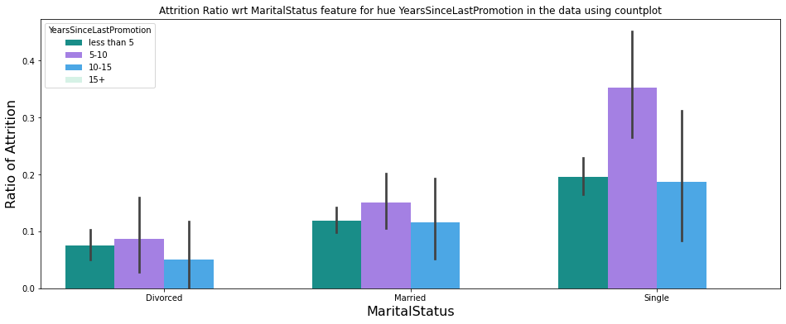
How does marital status affect Attrition?
The effect of this seems to be accentuated in employees with between 5-10 years since their last employment.

Slide 19
How does marital status affect Attrition?
The effect of this seems to be accentuated in employees with between 5-10 years since their last employment.

Slide 20
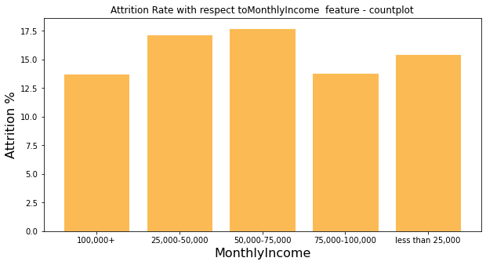
How does monthly income affect Attrition?
We see a slight decrease in attrition rate between groups making above 50,000 and those making below.
However, income is a poor predictor of the rate of attrition.

Slide 21
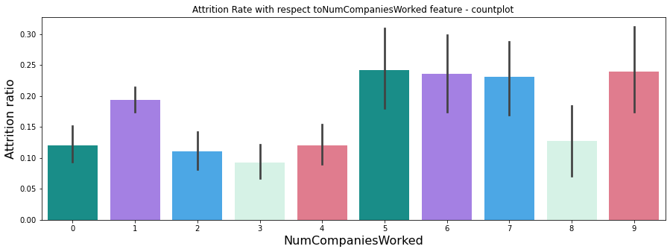
How does the number of previous companies worked affect Attrition?
We see employees with over 5 companies worked more than 60% more likely to leave than those with less.

Slide 22
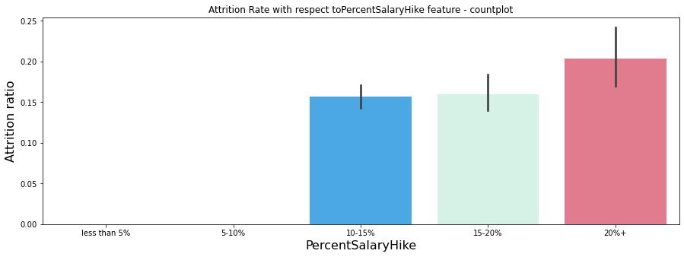
How does percent salary hike affect Attrition?
Increasing salaries proves to be an ineffective means to prevent attrition, with attrition rates slightly increasing with salary hikes.

Slide 23
Content
Overview
Univariate Analysis
Bivariate Analysis
Key Findings
Suggestions

Slide 24
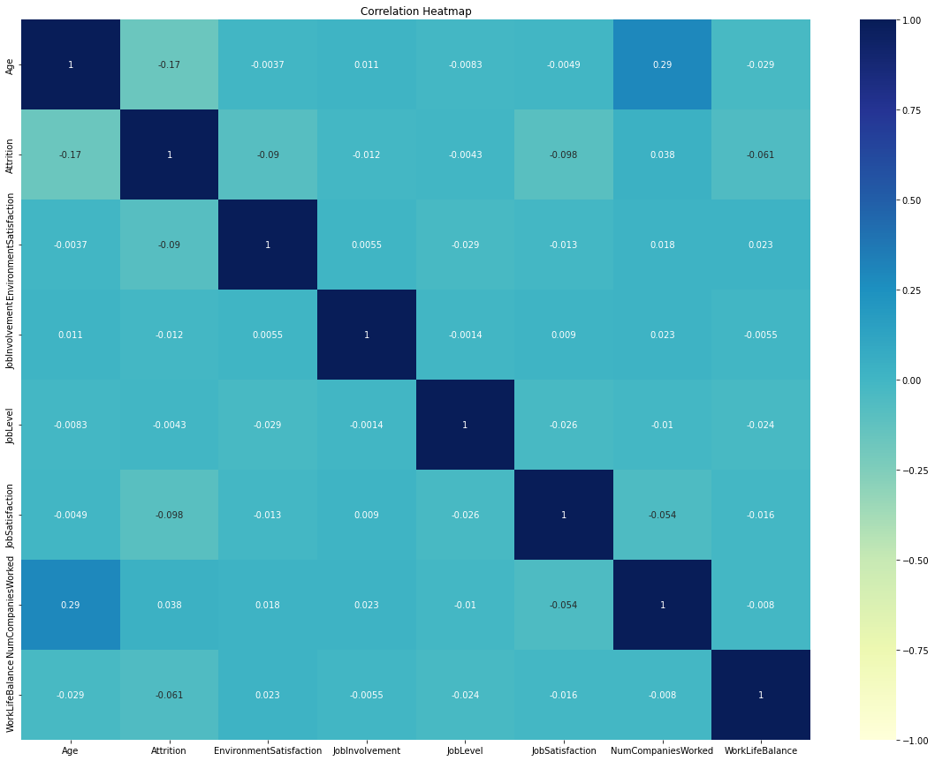
Which variable is most correlated with attrition?
We observe weak correlations across all variables signifying that there is not one driving contributor to high attrition rates.
Age is highest correlated with attrition, representing 17% of variation

Slide 25
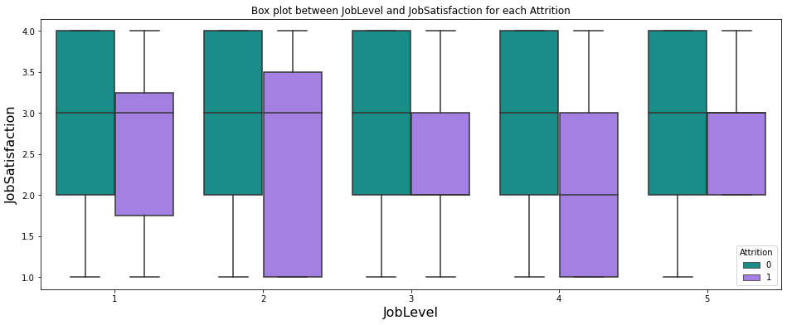
Is job level correlated with job satisfaction?
As job level increases we see no significant change in average job satisfaction amongst those who stay.
However, We see a decrease in those that leave

Slide 26
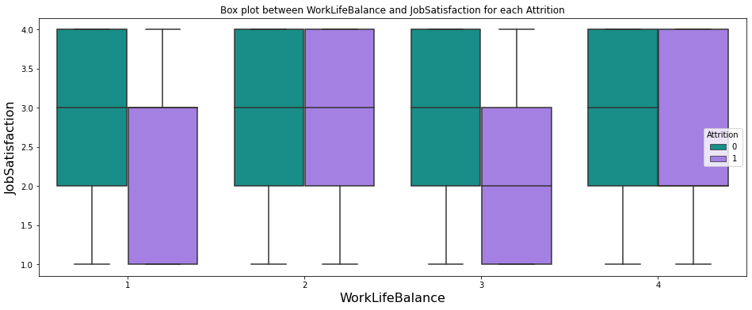
Is work life balance correlated with job satisfaction?
We see similar findings with steady levels for those that stay and diminishing levels in those that leave

Slide 27
Content
Overview
Univariate Analysis
Bivariate Analysis
Key Findings
Suggestions

Slide 28
Content
Overview
Univariate Analysis
Bivariate Analysis
Key Findings
Suggestions

Slide 29
Key findings
The subgroup with the highest levels of attrition are newly graduated employees between the ages of 18-24.
Attrition rate is very weakly correlated with pay increases or annual incomes.
The subgroup with the lowest levels of attrition are those in middle to upper management with few previous companies worked.

Slide 30
Content
Overview
Univariate Analysis
Bivariate Analysis
Key Findings
Suggestions

Slide 31
Suggestions
Designing a new employee rewards scheme, that prioritises non-monetary sources of motivation, such as improved work flexibility and career development could incentivise younger workers to stay further.
Re-investment into work environment could improve environmental satisfaction scores, leading to augmented job satisfaction levels.

